Slide 1
Spatial interpolation of Growing degree day
Samikshya Subedi

Slide 2
What is Growing Degree Day?
GDD is an index calculated by daily temperature data which is used to predict when a crop reach maturity of certain stages of development.
There are web-based tools that integrates current conditions, historical climate data, and projections of GDD through the end of the growing season based on various weather stations computer model forecasts and climatology to provide decision support on a variety of issues throughout the crop growth.
Uses mathematical calculation system.
Tracks and predicts stages of plant growth year to year.

Slide 3
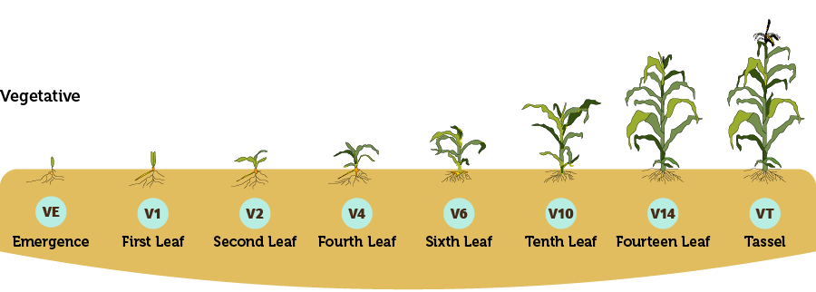
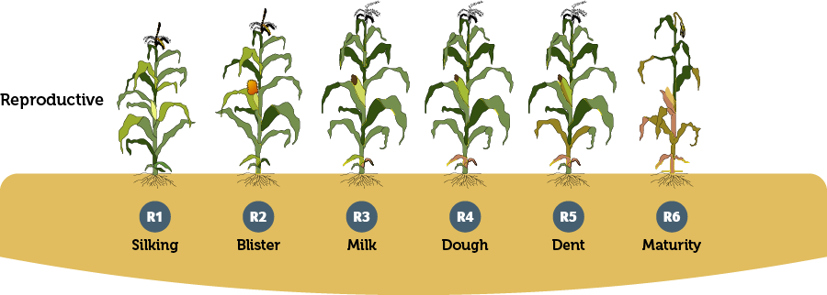
Corn Growth Stages

Slide 4
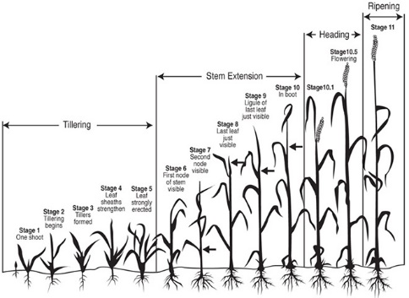
Wheat Growth Stages

Slide 5
What does it involve?
Record daily high and low temperature and find and average temperature of the day.
Base temperature for each crop is always constant.
Base temperature: Base Temperature is the cool temperature a which a plant does not develop. At or below the base temperature, plants no longer develop or grow.

Slide 6
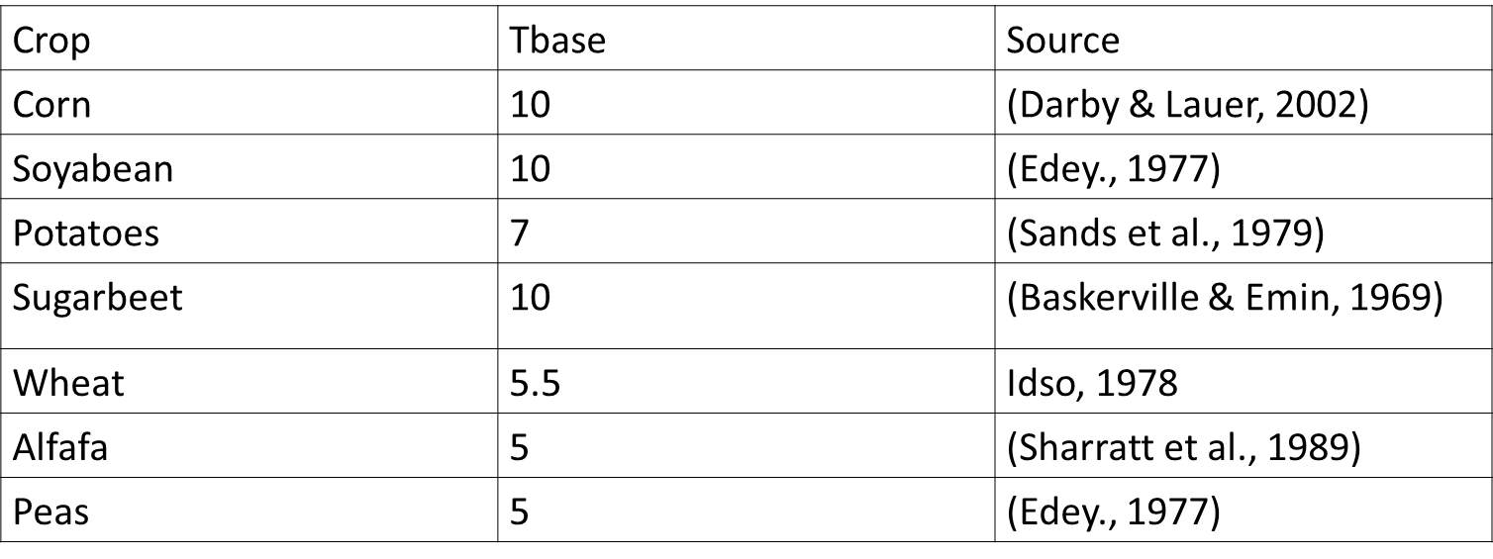
Base temperature for the application of growing degree day model

Slide 7
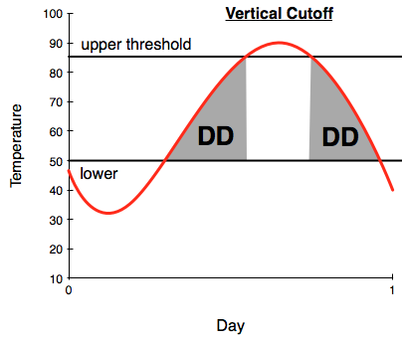
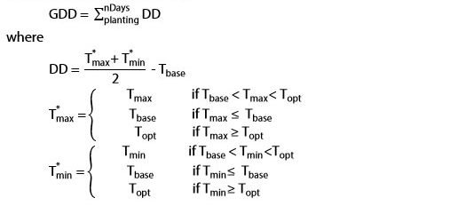
Growing Degree Day (GDD) Calculation

Slide 8
Purpose of Study
Farmers lack a model to forecast when their harvest will be fully grown.
This study's goals is to calculate the number of accumulated growth degree days (AGDD) that crops would require (corn and wheat)

Slide 9
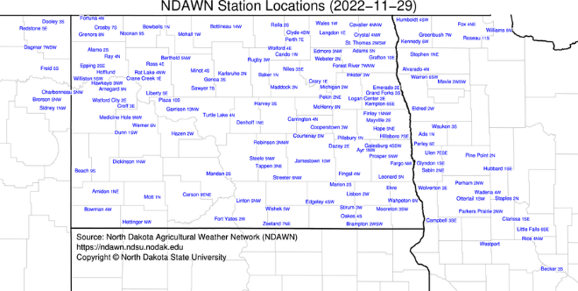
Study area
All NDAWN weather stations

Slide 10
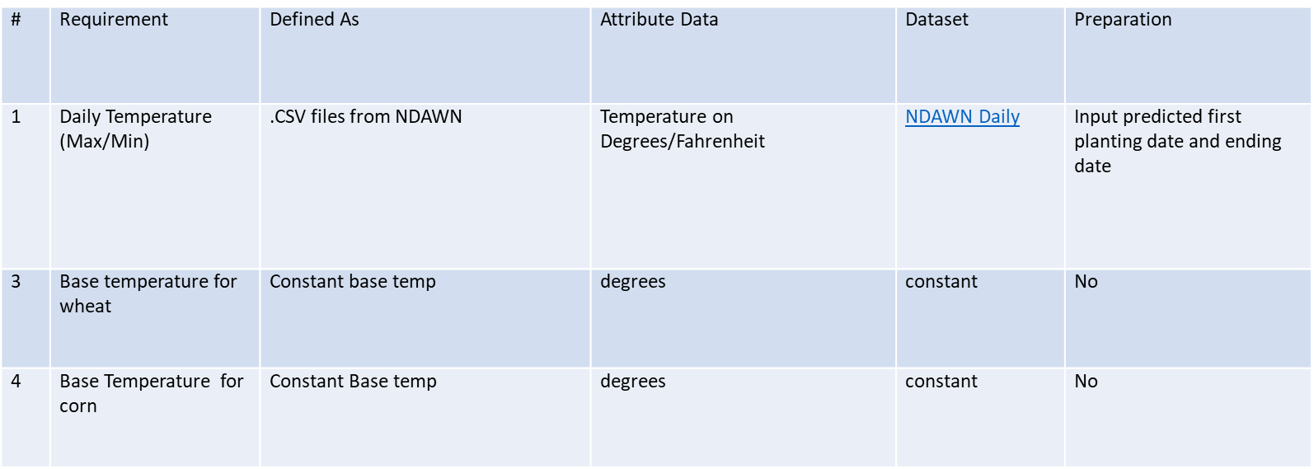
Data requirement for growing degree day calculations

Slide 11
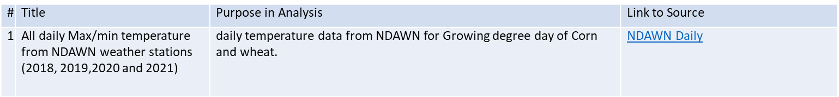
Accumulated Growing degree day data for corn and wheat

Slide 12
Problem Statement
To compare Calculated Growing Degree Day for Corn and Wheat for all NDAWN weather stations in years 2018, 2019, 2020 and 2021
To build an ETL pipeline in ArcPro Jupyter Notebooks that downloads the daily temperature data .csv files for min/max temperature from NDAWN, use data into Growing Degree day calculation.

Slide 13
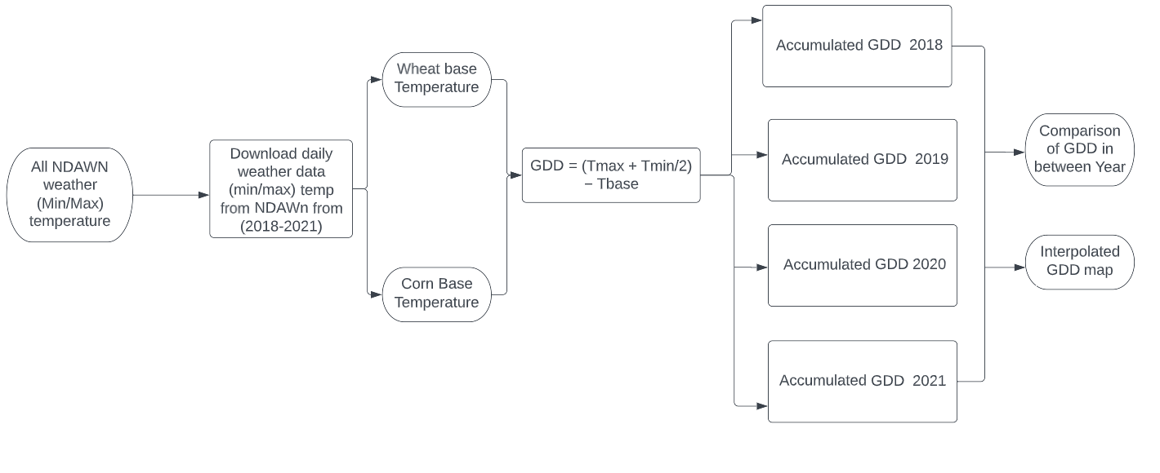
Work Flow Diagram

Slide 14
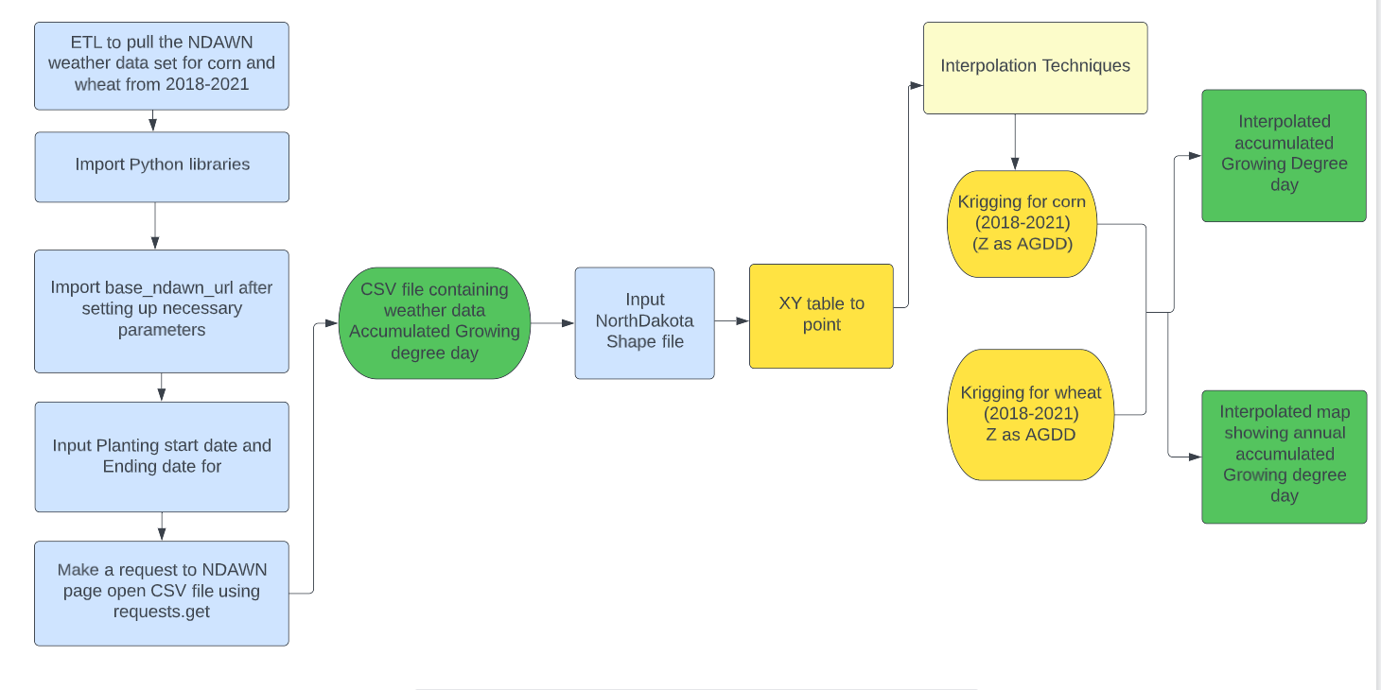
Data flow diagram
Kriging is most appropriate when you know there is a spatially correlated distance data. It is often used in Agriculture Science.

Slide 15
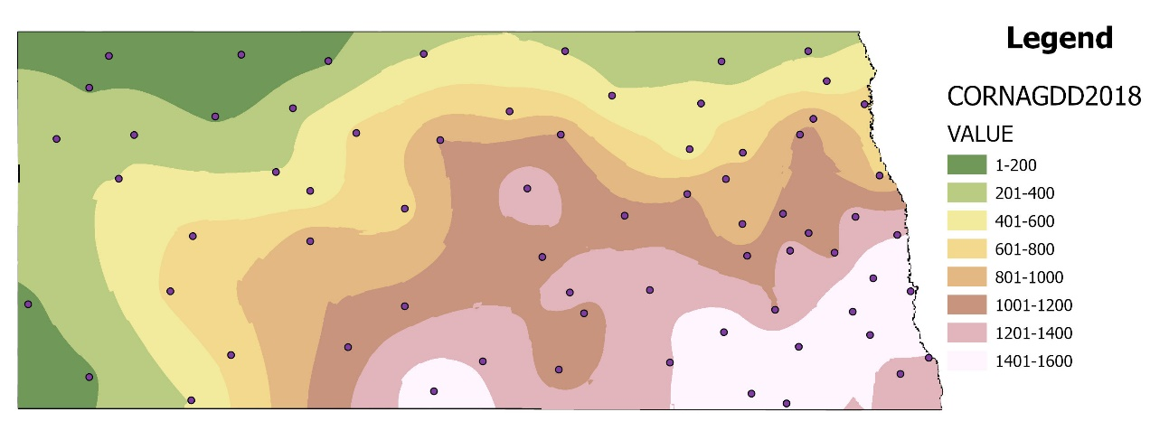
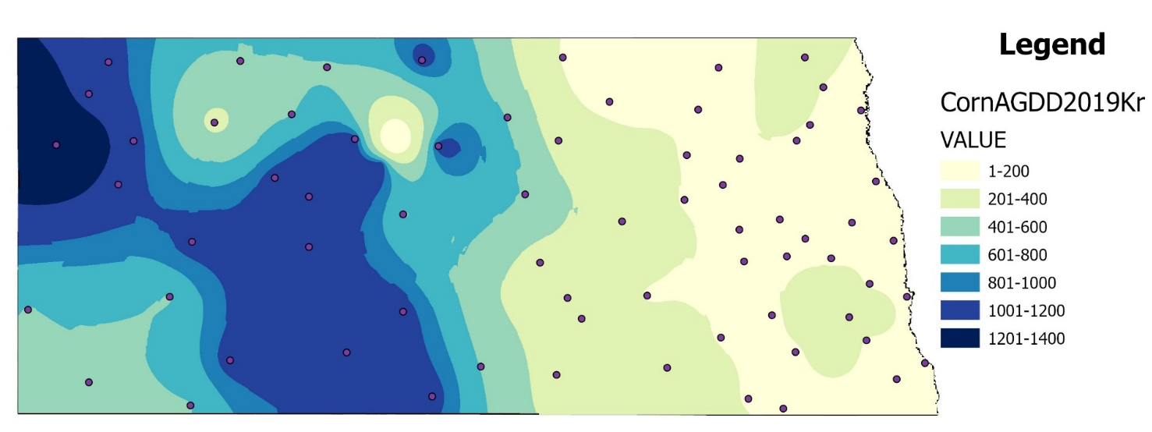
Results: Spatial interpolation of annual accumulated Growing Degree Day :Corn
Corn AGDD 2018: Map showing spatial interpolation of annual Accumulated Growing Degree Days in 2018
Corn AGDD 2019: Map showing spatial interpolation of annual Accumulated Growing Degree Days in 2019

Slide 16
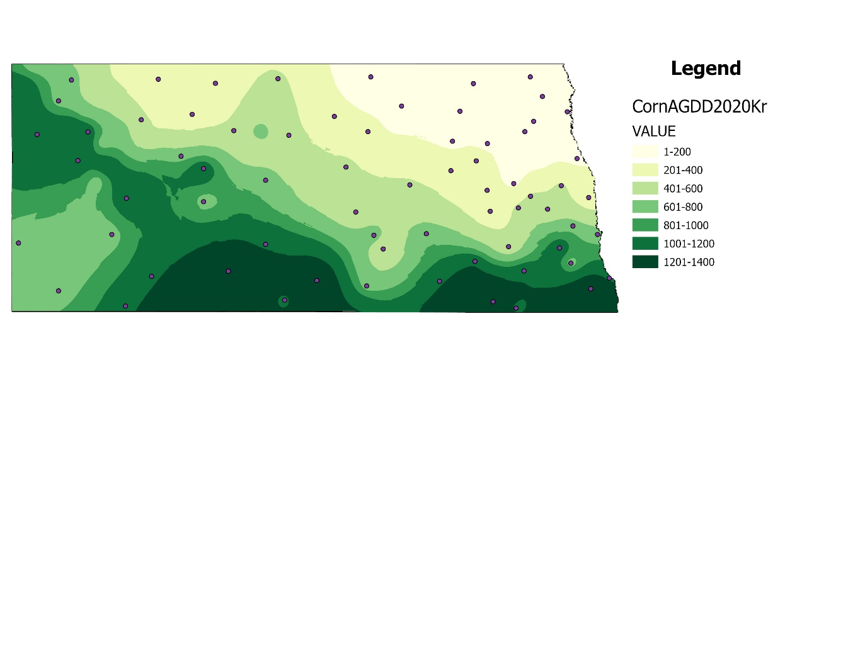
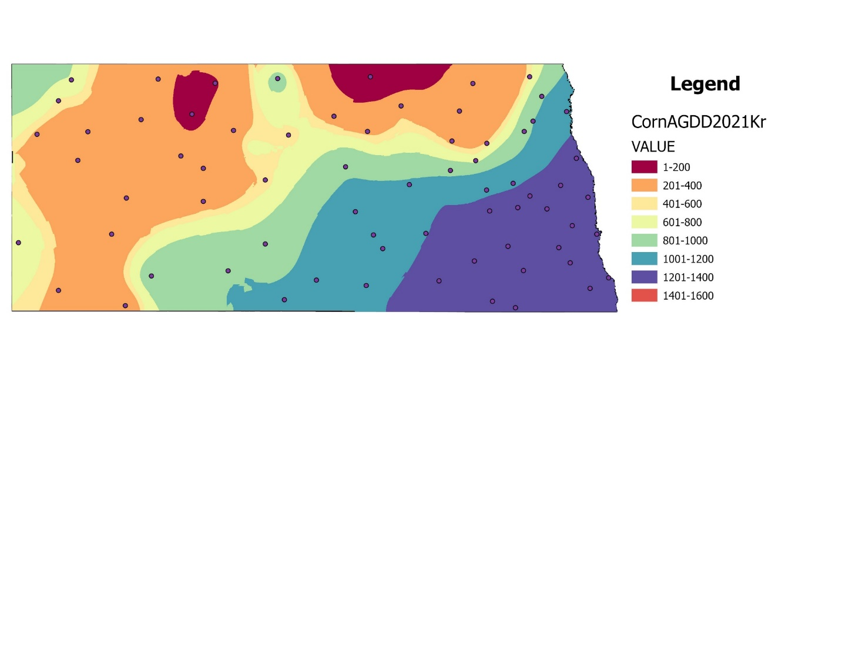
Spatial interpolation of annual accumulated Growing Degree Day: Corn
Corn AGDD 2020: Map showing spatial interpolation of annual Accumulated Growing Degree Days in 2020
Corn AGDD 2021: Map showing spatial interpolation of annual Accumulated Growing Degree Days in 2021

Slide 17
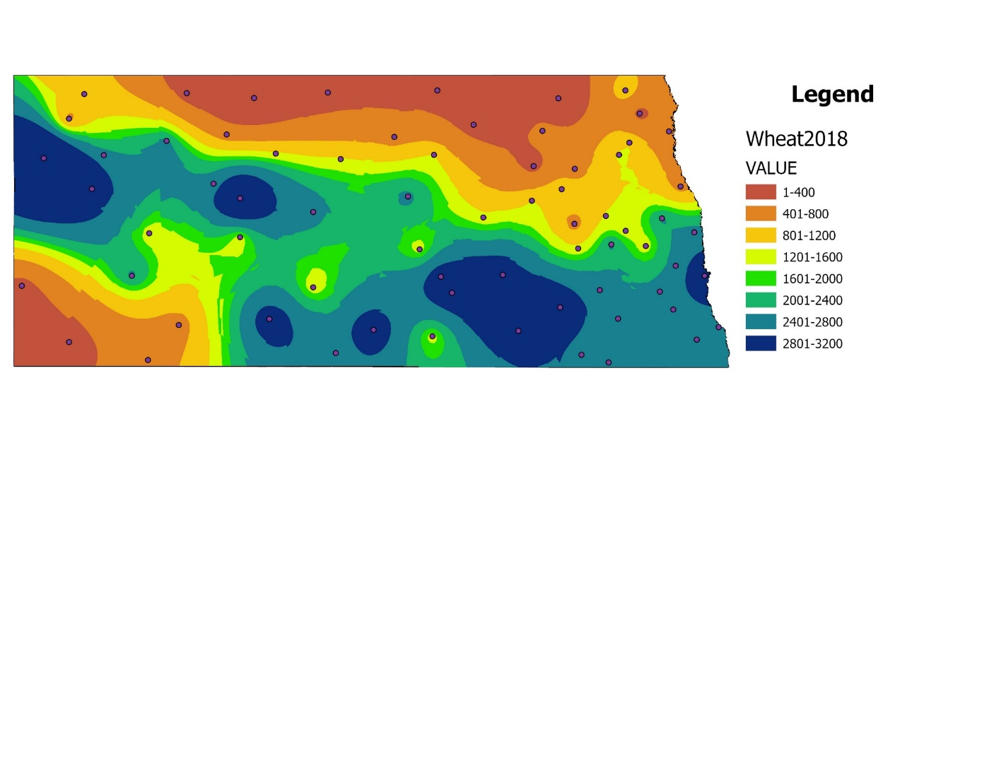
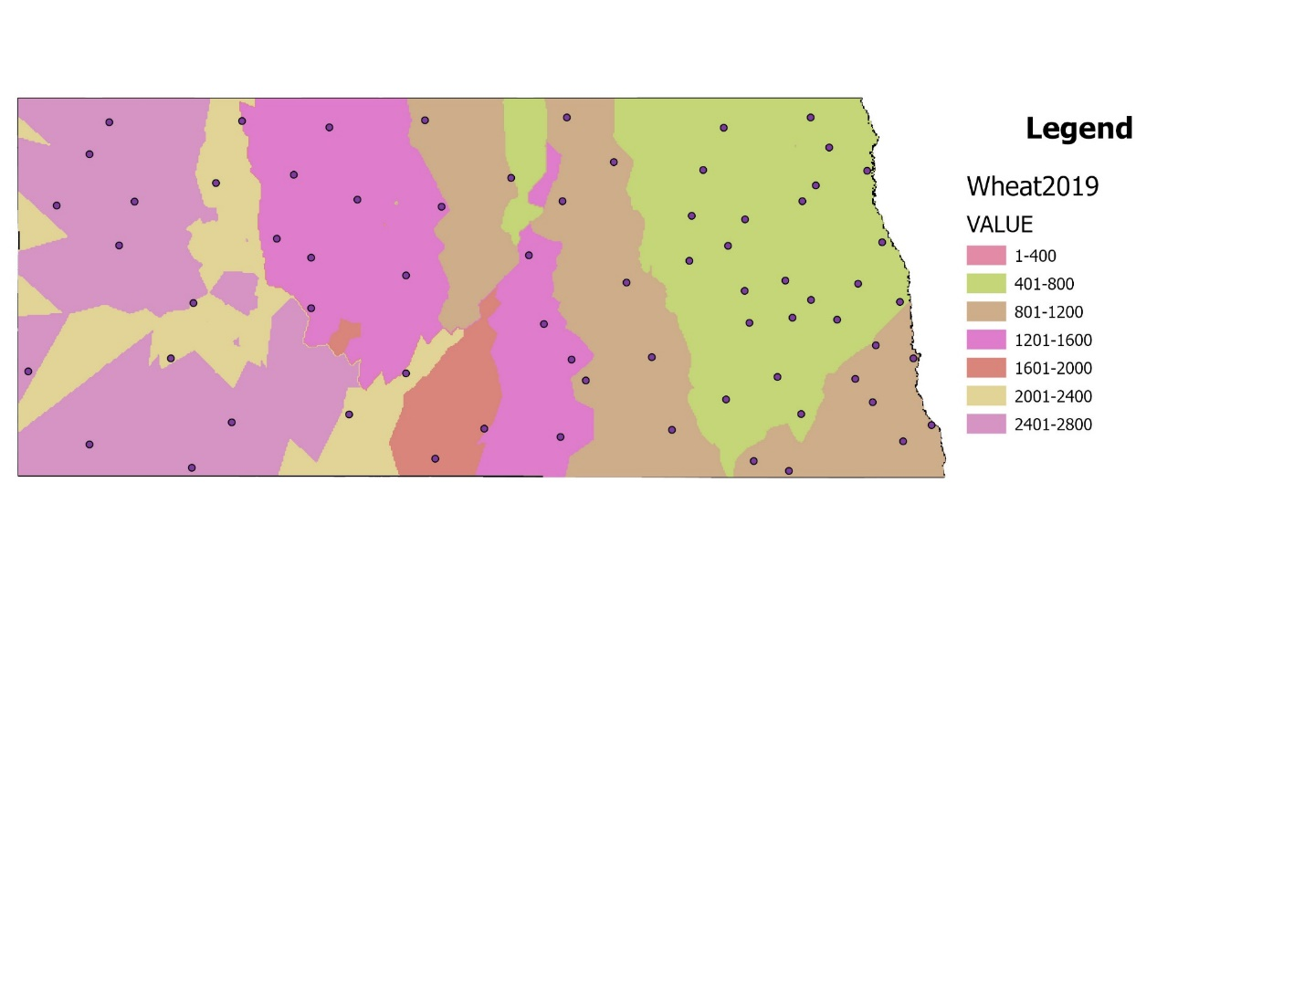
Spatial interpolation of annual accumulated Growing Degree Day: Wheat
Wheat AGDD 2018: Map showing spatial interpolation of annual Accumulated Growing Degree Days in 2018
Wheat AGDD 2019: Map showing spatial interpolation of annual Accumulated Growing Degree Days in 2019

Slide 18
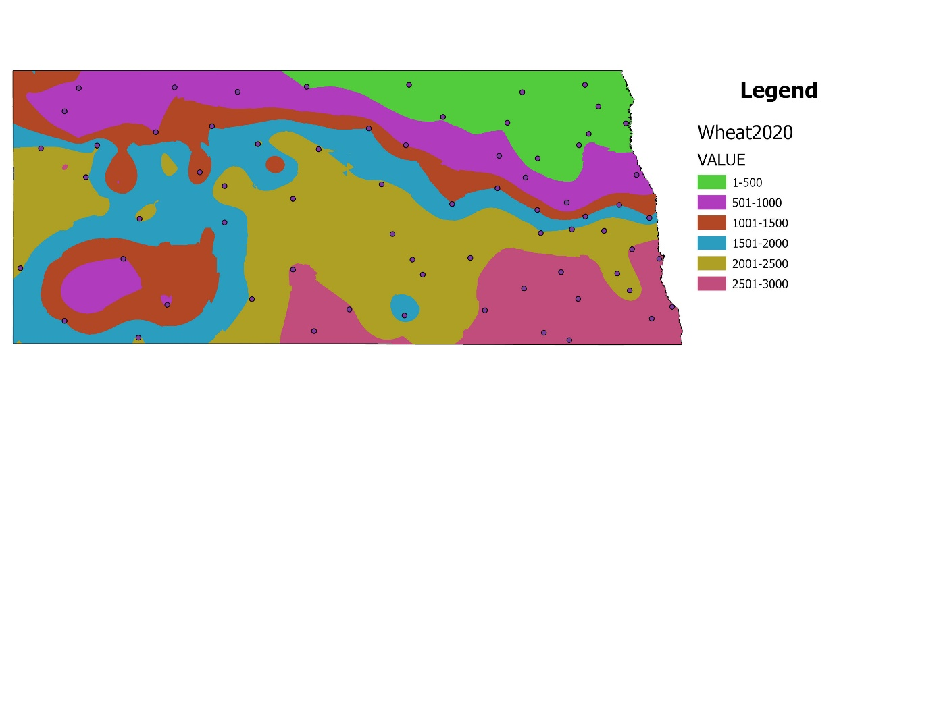
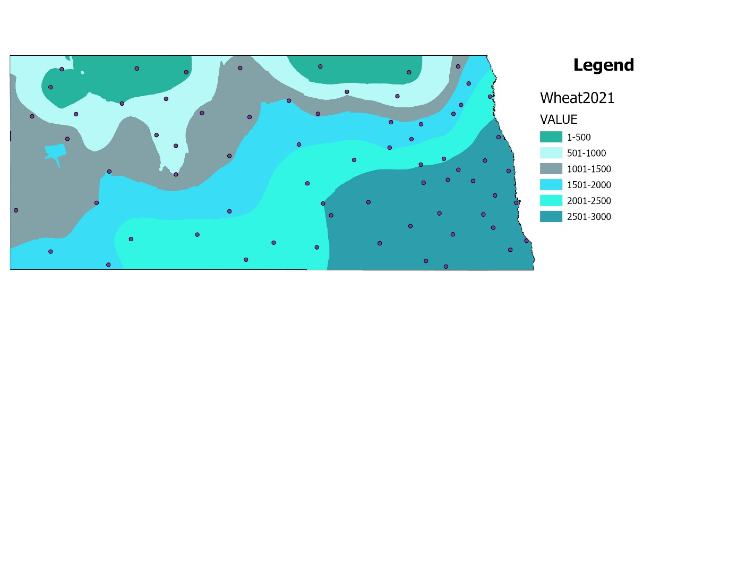
Spatial interpolation of annual accumulated Growing Degree Day: Wheat
Wheat AGDD 2020: Map showing spatial interpolation of annual Accumulated Growing Degree Days in 2020
Wheat AGDD 2021: Map showing spatial interpolation of annual Accumulated Growing Degree Days in 2021

Slide 19
Literature review:
Crop | AGDD | Growth Stage
Wheat | 0-600 | tillering
Wheat | 600-800 | strongly upright tillers
Wheat | 600-1000 | first nodes
Wheat | 1000-1200 | flag emergence
Wheat | 1600-1800 | Heading to flowering
Wheat | 2000-2200 | Flowering
Wheat | 2200-2400 | Watery ripe or milk
Wheat | 2400-2600 | Milk or dough
Wheat | 2600-2800 | Kernels
Wheat | 2800-3000 | Kernels maturing
Wheat | > 3000 | Approaching harvest
Crop | AGDD | Growth Stage | Staging name
Corn | 52 | Emergence | VE
Corn | 246 | Tassel | V6
Corn | 621 | Tassel emergence | VT
Corn | 760 | Silking stage | R1
Corn | 1051 | Dough Stage | R4
Corn | 1343 | Dent Stage | R5
Corn | 1482 | Physiological maturity | R6
Corn: (Hoeft et al., 2000)
Wheat: eupdate KSU

Slide 20
Thank you

Slide 21
References
Kukal, M. S., & Irmak, S. (2018). US agro-climate in 20th century: Growing degree days, first and last frost, growing season length, and impacts on crop yields. Scientific reports, 8(1), 1-14.
Miller, P., Lanier, W., & Brandt, S. (2001). Using growing degree days to predict plant stages. Ag/Extension Communications Coordinator, Communications Services, Montana State University-Bozeman, Bozeman, MO, 59717(406), 994–2721.

